Slide 1
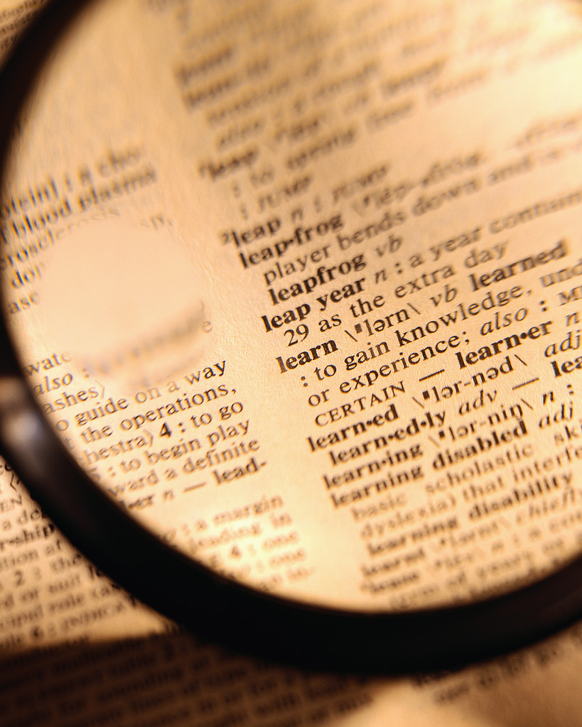
Key words associated with trust

Slide 2
Top 5 words

Slide 3
And the last 5 words Trust = Hope

Slide 4
Trust = Faith

Slide 5
Trust = Confidence

Slide 6
Trust = Assurance

Slide 7
Trust = Optimism

